Slide 1
jQuery Mobile

Slide 2
HTML Interface
HTML and CSS
iWebKit
jQTouch
Sencha Touch
BlackBerry UI
Notes:
iWebKit: Allows you to create HTML that matches the look and feel of native iPhone applications. http://snippetspace.com/
jQTouch: Is a jQuery plug-in on Iphone and Ipod-Touch. http://www.jqtouch.com
Sencha Touch(Ext Js + jQTouch + Raphaël): Allows you to develop mobile web apps that look and feel native on iPhone, Android, and BlackBerry touch devices. www.sencha.com/products/touch
Raphaël is a small JavaScript library that should simplify your work with vector graphics on the web. If you want to create your own specific chart or image crop and rotate widget, for example, you can achieve it simply and easily with this library.
BlackBerry UI: HTML 4 and CSS 2.1

Slide 3


Slide 4

Goals and Strategy
Seriously cross-platform & cross-device

Slide 5
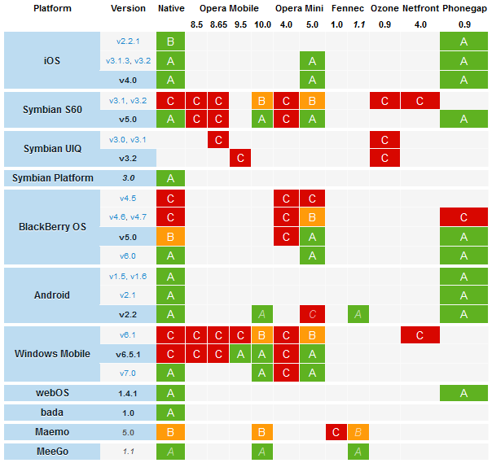
Notes:
A High Quality. A browser that’s capable of, at minimum, utilizing media queries (a requirement for jQuery Mobile). These browsers will be actively tested against but may not receive the full capabilities of jQuery Mobile.
B Medium Quality. A capable browser that doesn’t have enough market share to warrant day-to-day testing. Bug fixes will still be applied to help these browsers.
C Low Quality. A browser that is not capable of utilizing media queries. They won’t be provided any jQuery Mobile scripting or CSS (falling back to plain HTML and simple CSS).
Upcoming browser. This browser is not yet released but is in alpha/beta testing.

Slide 6
Goals and Strategy
A-grade - Full enhanced experience with Ajax-based animated page transitions.
B-grade - Enhanced experience except without Ajax navigation features.
C-grade - Basic, non-enhanced HTML experience that is still functional
Not Currently Supported in Beta 1

Slide 7

Build on Standards

Slide 8


…and on jQuery core

Slide 9
Advantages
Accessibility
Gradual improvement
Ajax loading pages
URL friendly
Theme
Notes:
Built on jQuery core for familiar and consistent jQuery syntax and minimal learning curve
Compatible with all major mobile platforms - iOS, Android, Blackberry, Palm WebOS, Nokia/Symbian, Windows Mobile, bada, MeeGo with baseline support for all devices that understand HTML
Lightweight size (12k compressed for all mobile functionality) and minimal image dependencies for speed.
HTML5 Markup-driven configuration of pages and behavior for fast development and minimal required scripting.
Progressive enhancement approach brings core content and functionality to all mobile, tablet and desktop platforms and a rich, installed application-like experience on newer mobile platforms.
Automatic initialization by using HTML5 data-role attributes in the HTML markup to act as the trigger to automatically initialize all jQuery Mobile widgets found on a page.
Accessibility features such as WAI-ARIA are also included to ensure that the pages work for screen readers (e.g. VoiceOver in iOS) and other assistive technologies.
New events streamline the process of supporting touch, mouse, and cursor focus-based user input methods with a simple API.
New plugins enhance native controls with touch-optimized, themable controls.
Powerful theming framework and ThemeRoller application make highly-branded experiences easy to build.

Slide 10
HTML5 Document
<!DOCTYPE HTML>
<html>
<head>
<title>jQuery Mobile</title>
<link rel="stylesheet" href="css/jquery.mobile-1.0a4.1.min.css" />
<script src="js/jquery.1.6.1.min.js"></script>
<script src="js/jquery.mobile-1.0a4.1.min.js"></script>
</head>
<body>
<!-- TODO -->
</body>
</html>
Notes:
<meta name="viewport" content="width=device-width, minimum-scale=1, maximum-scale=1" />

Slide 11
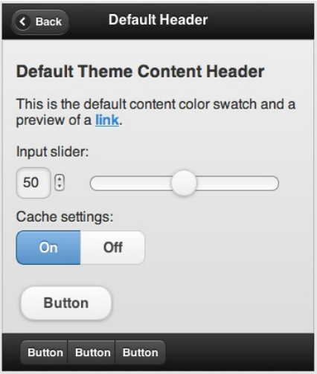



Create a page
<body>
<section data-role="page">
<header data-role=“header”>
</header>
<div data-role=“content”>
</div>
<footer data-role=“footer”>
</footer>
</section>
</body>

Slide 12
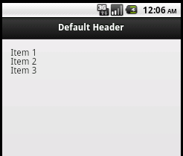
Basic list
<section id="page" data-role="page">
<header data-role="header">
<h1>Default Header</h1>
</header>
<div data-role="content" class="content">
<ul>
<li>Item 1</li>
<li>Item 2</li>
<li>Item 3</li>
</ul>
</div>
</section>

Slide 13
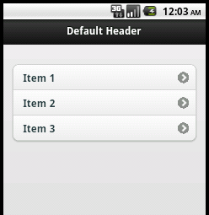
Add listview role
<section id="page" data-role="page">
<header data-role="header">
<h1>Default Header</h1>
</header>
<div data-role="content" class="content">
<ul data-role="listview" data-inset="true">
<li><a href=“#detail">Item 1</a></li>
<li><a href=“#detail">Item 2</a></li>
<li><a href=“#detail">Item 3</a></li>
</ul>
</div>
</section>

Slide 14
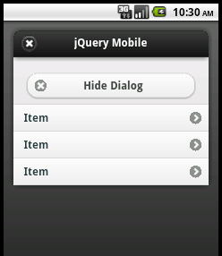
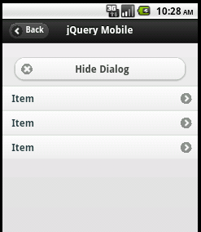
Dialog
<a href="lecentral.html" data-role="button" data-icon="forward“ >Show Dialog</a>
data-rel=“dialog”

Slide 15
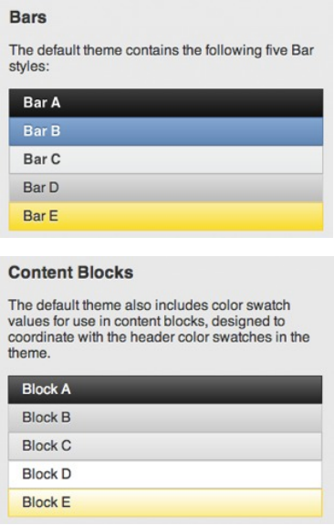
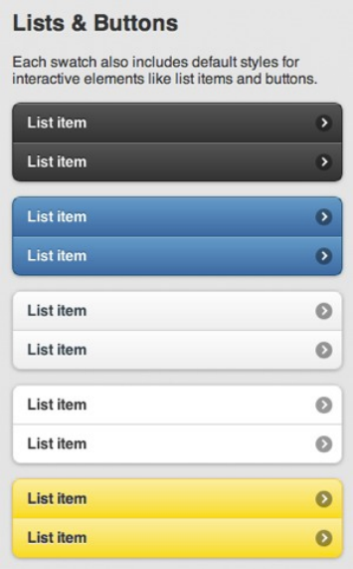
Theme swatches

Slide 16
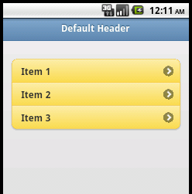
Theme swatches
<section id="page" data-role="page">
<header data-role="header" data-theme=“b">
<h1>Default Header</h1>
</header>
<div data-role="content" class="content">
<ul data-role="listview" data-inset="true" data-theme="e">
<li><a href=“#detail">Item 1</a></li>
<li><a href=“#detail">Item 1</a></li>
<li><a href=“#detail">Item 1</a></li>
</ul>
</div>
</section>

Slide 17
Links
External page links
Multi-page documents
Via jQuery Mobile

Slide 18
External page links
<section id="page" data-role="page">
<header data-role="header" data-theme=“b">
<h1>Default Header</h1>
</header>
<div data-role="content" class="content">
<ul data-role="listview" data-inset="true" data-theme="e">
<li><a href=“products.html">Products</a></li>
<li><a href=“services.html">Services</a></li>
<li><a href=“about.html">About us</a></li>
<li><a href=“contact.html">Contact</a></li>
</ul>
</div>
</section>

Slide 19
Multi-page documents
Each “page” has a unique ID
<body>
<div data-role="page" id="home">
</div><!-- /home page -->
<div data-role="page" id="products">
</div><!-- /products page -->
<div data-role="page" id="services">
</div><!-- /services page -->
<div data-role="page" id="about">
</div><!-- /about page -->
<div data-role="page" id="contact">
</div><!-- /contact page -->
</body>

Slide 20
Multi-page documents
...with internal #anchor links
<div data-role="content" data-theme="a">
<ul data-role="listview" data-inset="true">
<li><a href="#products">Products</a></li>
<li><a href="#services">Services</a></li>
<li><a href="#about">About us</a></li>
<li><a href="#contact">Contact</a></li>
</ul>
</div><!-- /homepage content -->
…

Slide 21
Effects transition
Slide
Slideup
Slidedown
Pop
Face
Flip
<a href="#products“ data-transition=“slide”>Products</a>

Slide 22
Via jQuery Mobile
Change Page
$.mobile.changePage(to, transition, back, changeHash)
…and Back!
window.history.back();
Notes:
• to: one of the following:
—a simple string denoting either an element ID or a filename
—an array of two elements, with the first being a simple string denoting the ele-
ment ID or filename of the page to transition from, and the second being a simple
string denoting the page to transition to
—an object with the following properties:
—url: the url string of the desired page
—type: the HTTP verb (“GET” or “POST”)
—data: serialized parameters to send to the url
• transition: the name of the desired transition
• back: a Boolean indicating whether or not the transition should be in reverse
• changeHash: a Boolean indicating whether or not the location.hash should be
updated upon successful transition

Slide 23
Passing Data Between Pages
HTML 5 DOM storage
Global variables
The jQuery.data() method
Notes:
HTML 5 DOM storage
You can use the HTML 5 sessionStorage or localStorage methods. This choice
leads in nicely to caching information even when the user ends their session. These
features are also widely supported in mobile browsers.
Global variables
Since all of the pages are in one DOM, you can easily use global variables to transmit
information from one page to another. One page sets a variable, and when the next
page loads, it checks the same variable and retrieves the information. Global
variables are generally frowned upon as bad development practice, but if you
namespace the variables appropriately, it can be a quick, effective method to use.
The jQuery.data() method
You can store data directly in DOM elements using the jQuery.data() method.
You can read more about the jQuery.data() method in the jQuery documentation,
but basically it allows you to attach key-value pairs to any DOM element. Since all
the pages in a jQuery Mobile application are in the same DOM, any page can access
the data attached to any element.

Slide 24
Configuring Defaults
defaultTransition (string, default: 'slide')
loadingMessage (string, default: "loading")
errorMessage (string, default: "Error loading page")
backBtnText (string, default: 'back')
ajaxEnabled (boolean, default: true)
and more!

Slide 25
Overriding Defaults
Extend the $.mobile object:
$(document).bind("mobileinit", function(){
$.extend( $.mobile , {
foo: bar
});
});
...or set individually:
$(document).bind("mobileinit", function(){
$.mobile.foo = bar;
});

Slide 26
Overriding Defaults
<script src=“js/jquery.1.6.1.min.js"></script>
<script src="js/defaults.js"></script>
<script src="js/jquery.mobile-1.0b4.1.min.js"></script>

Slide 27
Useful links
Documentation: http://jquerymobile.com
Inspiration: http://jqmgallery.com
Github: https://github.com/jquery/jquery-mobile

Slide 28
Last but not least…
Thanks jQuery Mobile Team

